Slide 1

Deep DPM: Deep Clustering
With an Unknown Number of Clusters
2023. 01. 18
Presenter : Taewoong Kang
twk@deepnoid.com

Slide 2
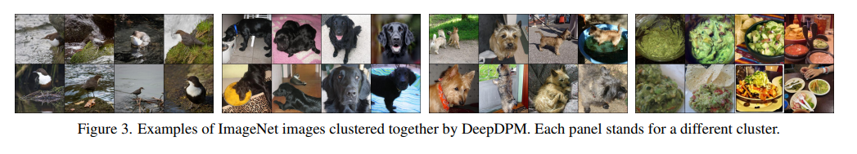
Abstract
Abstract
Effective Deep-clustering method
(When K is unknown, model become computationaly expensive)
Does not require knowing the value of K
Using split/merging framework, a dynamic architecture, novel loss

Slide 3
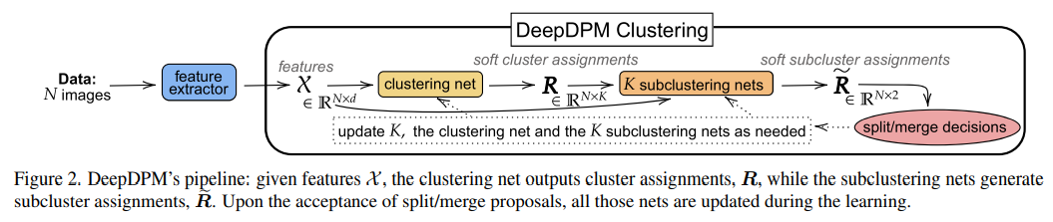
Method
Architecture
Embedding
(use MOCO)
Cluster A, B,.., K
Cluster A1, A2
…
Cluster K1, K2
Change K

Slide 4
Preliminaries : DPGMM-based Clustering
Notations
Cluster label

Slide 5
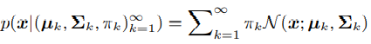
Preliminaries : DPGMM-based Clustering
DPGMM(the Dirichlet Process Gaussian Mixture Model)
BNP(Bayesian nonparametric) extension of GMM
Notations
Gaussian pdf(probability density function)
are iid, draws from their prior, typically a NIW distribution
are drawn using the GEM(the Griffiths-Engen-McCloskey stick-breaking process)
the concentration parameter

Slide 6
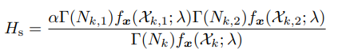
Preliminaries : DPGMM-based Clustering
Metropolis-Hastings framework
Hasting Ratio
Is the marginal likelihood where represents the NIW hyperparameters

Slide 7
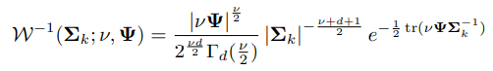
Preliminaries : DPGMM-based Clustering
NIW
A conjugate prior to the multivariate normal distribution with an unknown mean and unknown covariance matrix -> posterior probability will be in the same distribution
Algebraically convenient to inference
Pdf of Inverse-Wishart(IW)
Symmetric and Positive Definite(SPD)

Slide 8
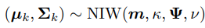
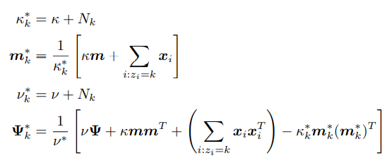
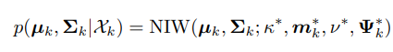
Preliminaries : DPGMM-based Clustering
NIW
Pdf of Normal-Inverse-Wishart(NIW)
Posterior hyperparameters

Slide 9
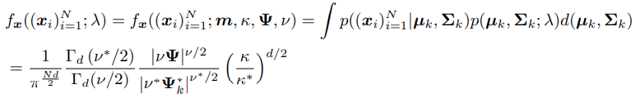
Preliminaries : DPGMM-based Clustering
Marginal Likelihood Function
When marginalizing over the parameters of the Gaussian, one obtains the marginal data likelihood

Slide 10
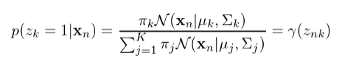
Method
DeepDPM
Clustering net
Given the current value K, the data is passed to the clustering net.
Generates K soft cluster assignments
We compute the hard assignments

Slide 11
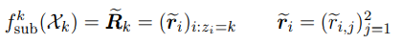
Method
DeepDPM
Subclustering net
Each subclustering net is fed with the data (hard-) assigned to its respective cluster
Generates soft subcluster assignments

Slide 12
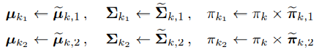
Method
Splits and Merges
Changing K via Splits and Merges
Splits
A split proposal is accepted stochastically with probability
Merges
Must ensure we never mistakenly merging three clusters together
Consider the merges of each cluster with only its 3 nearest neighbors
Merge proposal is accepted/rejected using a Hasting ratio
The parameter and the weight of the new-cluster are initialized using the weighted MAP estimation

Slide 13
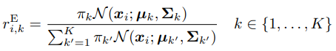
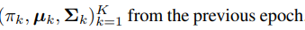
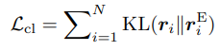
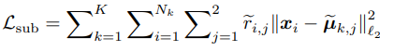
Method
Loss function
Motivated by EM(Expectation Maximization) in the Bayesian GMM
E step
Responsibility(책임값)
Each E step Is followed by a standard M step in the Bayesian GMM(except soft assignment used in MAP)

Slide 14
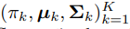
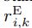
Method
Loss function
Bayesian M step
Use weighted versions of the MAP estimates of
Instead of we use as weights

Slide 15
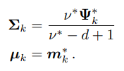
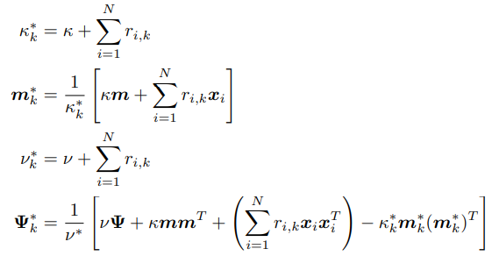
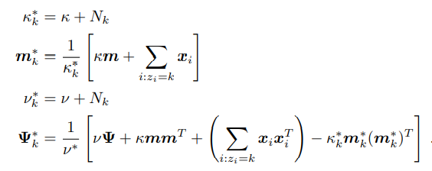
Method
Weighted MAP Estimates
In the unweighted case, we use ```Eq1
In weighted MAP, we still use Eq1, but instead of the posterior hyperparameters we use their weighted versions

Slide 16
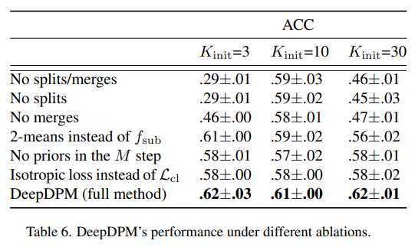
Method
Amortized EM Inference
Our method still yields results that are usually better than the standard EM
By the virtue of the smoothness of the function learned by the deep net, we improve the prediction for the points in no only the current batch but also other batches
The smoothness serves as an inductive bias, such that points should have similar labels
When using the GMM negative log likelihood instead of our loss, empirically that led to unstable optimization and/or poor results
On Fashion-MNIST

Slide 17
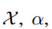
Method
A Weak Prior : Letting the Data Speak for Itself
The inferred K depends on and the NIW hyperparameters
Intentionally choose the prior to be very weak
When doing posterior calculation, if , where N is the number of data points, then the importance of diminishes
For example, v is very high and is small -> favor small clusters, thus K is likely to be high
v is very high and is large -> favor large clusters, so K will tend to be small
Our are all much smaller than N in all the datasets

Slide 18
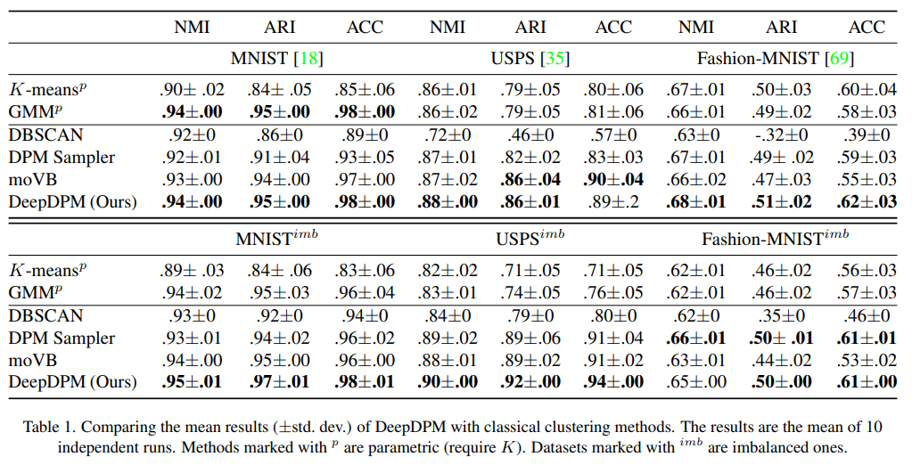
Results
Classical methods
Nonparametric ones are less affected by the imbalance.

Slide 19
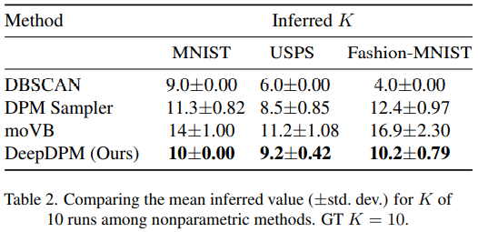
Results
Nonparametric method
DPM’s inferred K is the closest to GT K

Slide 20
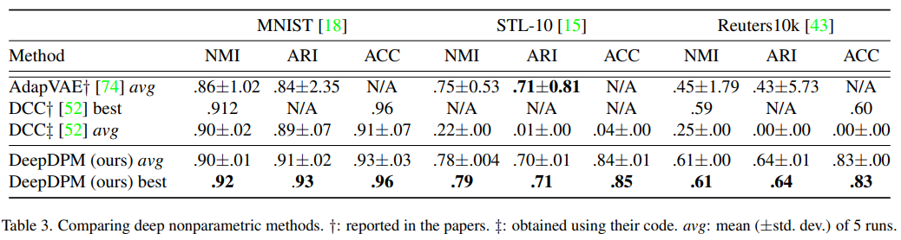
Results
Deep Nonparametric Methods

Slide 21
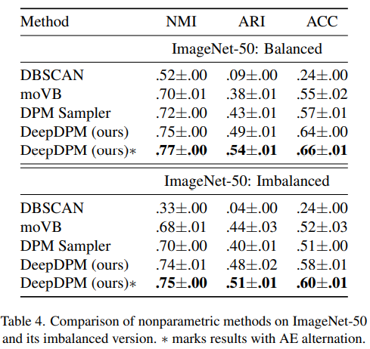
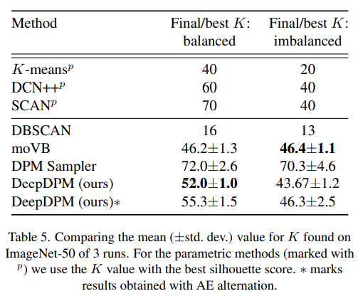
Results
The value of Deep Nonparametric Methods

Slide 22
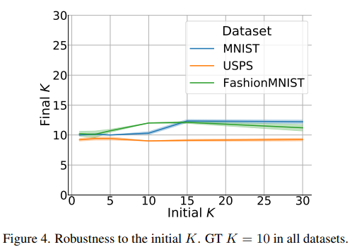
Results
Ablation Study and Robustness to the Initial K
On Fashion-MNIST

Slide 23
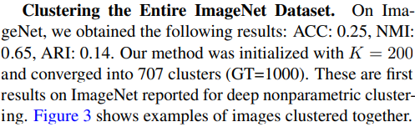
Conclusion
Limitations
If Deep-DPM’s input features are poor it would struggle to recover.
K is known and dataset is balanced, parametric methods may be a slightly better choice.
Summary
Outperforms deep and non-deep nonparametric methods and achieves SOTA results
Demonstrated the added value the nonparametric approach brings to deep clustering

Slide 24
Q & A

Slide 25
감사합니다

Slide 26
Method
Feature extraction
Changing K via Splits and Merges
Splits
A split proposal is accepted stochastically with probability
Merges
Must ensure we never mistakenly

